Slide 1
Design Patterns
Summer 2021

Slide 2
Principles & Patterns
Principle: a fundamental truth or proposition that serves as the foundation for a system of belief or behavior or for a chain of reasoning. (dictionary.com)
Pattern: a repeated design
Design pattern: a repeatable solution to a commonly occurring problem
  the idea originally introduced by Christopher Alexander in A Pattern Language: Towns, Buildings, Construction. (1977)
In general, a pattern has four essential elements
  Name
  Problem
  Solution
  Consequences
Supports chunking and incorporating that concept into our understanding and memory
Facilitates communication

Slide 3
OO Design Patterns and Principles
GoF (Gang of Four)
Creational | Structural | Behavioral
Abstract factory, Builder, Factory method, Prototype, Singleton | Adapter, Bridge, Composite, Decorator, Façade, Flyweight, Proxy | Chain of responsibility, Command, Interpreter, Iterator, Mediator, Memento, Observer, State, Strategy, Template method, Visitor
GRASP (General Responsibility Assignment Software Patterns or Principles)
Creator, Information Expert, Low Coupling, Controller, High Cohesion, Polymorphism, Pure Fabrication, Indirection, Protected variations
DRY (Don’t Repeat Yourself)
YAGNI (You Ain’t Gonna Need It)
SOLID
Single responsibility, Open-close, Liskov substitution, Interface segregation, Dependency inversion

Slide 4
Why use patterns or principles?
Change happens!
Two points of change
  Variation point: Variations in the existing, current system or requirements, e.g., file formats for an e-reader
  Evolution point: Speculative points of variation that may arise in the future, but which are not present in the existing requirements
Sometimes the cost of speculative “future-proofing” at evolution points outweighs the cost incurred by a simple, more brittle design that is reworked as necessary in response to the true change pressures.
Brittle design Balanced design Flexible, generalized design
Novice
Expert
Intermediate
Notes:
Variation point: variety of ways in which you can do one thing. For e.g. an eBook reader can read Pdf, HTML, MS-Word-Doc, etc.
Evolution point: variety of things that can be done. For e.g. eBook reader can also give features such as bookmarking, searching, highlighting, etc.

Slide 5
Class diagram
Component diagram
Object diagram
Structure
Composite structure diagram
Package diagram
UML Diagrams
Deployment diagram
Use case diagram
Activity diagram
Behavior
Sequence diagram
State machine diagram
Communication diagram
Interaction
Timing diagram
Interaction overview diagram

Slide 6
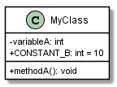
Classifier
Concrete class
Abstract class
Interface
Enumeration
Generic class
Active class

Slide 7


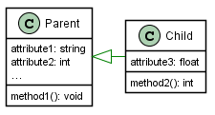


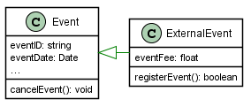




Association
Aggregation (shared ownership)
Inheritance (generalization)
Composition (single ownership)

Slide 8
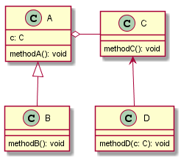
Some key concepts
Coupling: interdependence
  measures how strongly one element is connected to, has knowledge of, or depends on other elements. Common forms of coupling between X and Y
    Association: X uses Y
      X has a member variable as a reference to Y, or
      X calls on Y’s methods
    Inheritance: X inherits from Y
      X is a direct or indirect subclass of Y
    Implementation: X implements Y
      Y is an interface and X implements Y

Slide 9
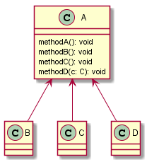
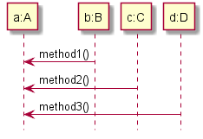
Some key concepts
Cohesion: focus
  measures how functionally related the operations of a software elements are.
  measured as degree of similarity of methods.
Modularity
    Property of a system that has been decomposed into a set of highly cohesive and loosely coupled modules.

Slide 10
Implications of coupling and cohesion
High coupling
  detrimental to modular design and prevents reuse
  makes one part of software sensitive to changes in other parts and therefore maintenance is more difficult
  requires more rigorous testing
Low Cohesion
  Increases complexity, thereby increasing the likelihood of errors during the development process
Some thumb rules
  A moderate degree of coupling between classes is normal and necessary for creating OO systems
  High coupling to stable elements is seldom a problem (e.g. library classes)
  A class with high cohesion has a relatively small number of methods with highly related functionality
  Low coupling and high cohesion increases reuse potential
  Often low cohesion causes high coupling and vice-versa

Slide 11
Reuse Mechanisms
White-box reuse: class inheritance (breaks encapsulation)
  Defined statically at compile time
  Allows modifying the implementation being reused by sub-classing and overriding
Black-box reuse: object composition
  Defined dynamically at run time through objects acquiring references to other objects
    New functionality is obtained by assembling or ‘composing’ objects to get more complex functionality.
    Requires carefully designed interfaces. Any object can be replaced at run-time as long as it has the same ‘interface’.
Notes:
Broadly speaking, object oriented approach provides two mechanisms of software reuse – white-box through inheritance and black-box through composition. As inheritance is established in the code, it is static in nature as its frozen at compile time. Object composition, because of things such as polymorphism or reflection, is decided at run time and hence is dynamic.
Inheritance: simple to understand and use. It breaks encapsulation. If parent class changes, it forces child class to change unless child class has overridden parent’s methods, or parent class is a pure abstract class. So when reusing a child-class, you have to make sure parent class doesn’t change or the change doesn’t impact the child class. (example: living with your parents impacts how you live ☺ )
Composition: requires carefully designed interfaces. But it doesn’t break encapsulation.
Therefore: Favor object composition over class inheritance.
However, object composition is harder for humans to understand. Also, dynamic reuse may cause performance inefficiencies.

Slide 12
Reuse Mechanisms
Window class keeps a reference to an instance of another class – Shape.
It delegates its ‘operations’ such as Area() to the Rectangle instance.
Rectangle object can be replaced with Circle at run time and Window will become circular
Window is a Rectangle
Window has a Shape
Rectangle
Window
Shape
Window
Rectangle
Favor object composition over class inheritance
  Delegation: a way of making composition as powerful for reuse as inheritance
    Extreme example of object composition
    Two objects involved in handling a request: A receiving object delegates operations to its delegate
Program to an interface, not an implementation: Don’t declare variables to be instances of concrete classes
Notes:
Broadly speaking, object oriented approach provides two mechanisms of software reuse – white-box through inheritance and black-box through composition. As inheritance is established in the code, it is static in nature as its frozen at compile time. Object composition, because of things such as polymorphism or reflection, is decided at run time and hence is dynamic.
Inheritance: simple to understand and use. It breaks encapsulation. If parent class changes, it forces child class to change unless child class has overridden parent’s methods, or parent class is a pure abstract class. So when reusing a child-class, you have to make sure parent class doesn’t change or the change doesn’t impact the child class. (example: living with your parents impacts how you live ☺ )
Composition: requires carefully designed interfaces. But it doesn’t break encapsulation.
Therefore: Favor object composition over class inheritance.
However, object composition is harder for humans to understand. Also, dynamic reuse may cause performance inefficiencies.

Slide 13
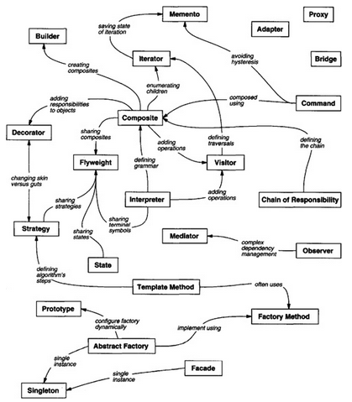
Design Pattern Relationships
Source: GoF

Slide 14
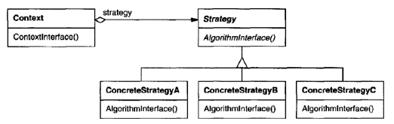
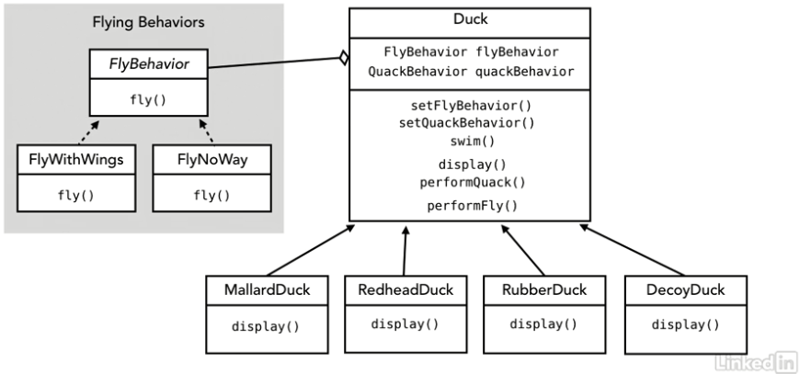
Strategy Pattern
Problem: Varying behavior across inheritance tree
Pattern Intent
  Define a family of algorithms, encapsulate each one, and make them interchangeable. Strategy lets the algorithm vary independently from clients that use it.
AKA: Policy
Identify behaviors that vary across related classes
Define a common interface for those behaviors
Create concrete classes that implement this interface differently
Make the Client ‘composed of’ one of these concrete classes as its ‘Strategy’

Slide 15
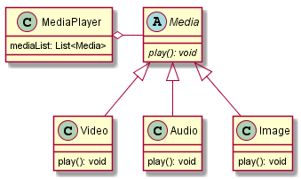
Strategy Pattern
Example: For a MediaPlayer
Different media have different ‘play’ behaviors.
In future, we may want
  Professional media that has play() with transcript
  Text, then ‘Can't play! Just display!’ behavior code will be duplicated
@Override
void play() {
  System.out.println("Playing mp4");
}
@Override
void play() {
  System.out.println("Playing mp3");
}
@Override
void play() {
  System.out.println("Can't play! Just display!");
}

Slide 16
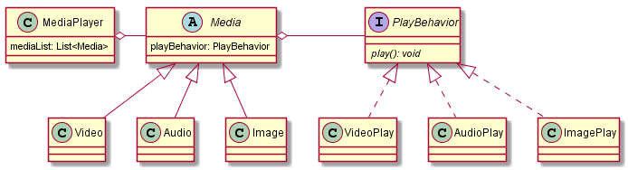
Strategy Pattern
mediaList.get(i).playBehavior.play()
Video() {
  playBehavior = new VideoPlay()
}
@Override
void play() {
  System.out.println("Playing mp4");
}
Audio() {
  playBehavior = new AudioPlay()
}
@Override
void play() {
  System.out.println("Playing mp3");
}
Image() {
  playBehavior = new ImagePlay()
}
@Override
void play() {
  System.out.println("Can't play! Just display!");
}

Slide 17
Strategy Pattern: Clock Example
Problem:
Too much variation in alarm-setting behavior across various clocks
Future devices may have different alarm behaviors, e.g. a MicrowaveClock with phone app to set alarm
Can’t set alarm
Wind clock to set alarm
Use phone app to set alarm
Set alarm on device
Set alarm on device

Slide 18
Strategy Pattern: Clock Example
Solution:
Create interface AlarmBehavior. Implement it with concrete classes
  NoAlarmBehavior
  WindAlarmBehavior
  AlarmAppBehavior
  DeviceAlarmBehavior
Define AlarmBehavior as memberVariable in Clock. Pass an instance of appropriate alarm behavior when constructing an instance of Clock

Slide 19
Abstract factory / Factory method pattern: Clock factory
How will you create Digital and Analog clocks?
First create the factories:
ClockFactory dcf = new DigitalClockFactory()
ClockFactory acf = new AnalogClockFactory()
Then ask the specific factory to create its clock
For Digital clock,
Clock clock = dcf.createClock();
For Analog clock,
Clock clock = acf.createClock();
Abstract factory
Abstract product
Concrete factories
Concrete products

Slide 20
Abstract Factory Pattern: University

Slide 21

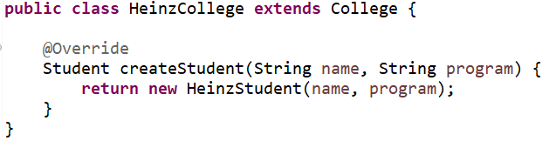
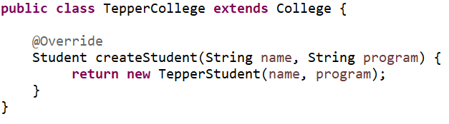
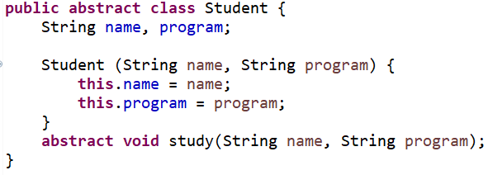
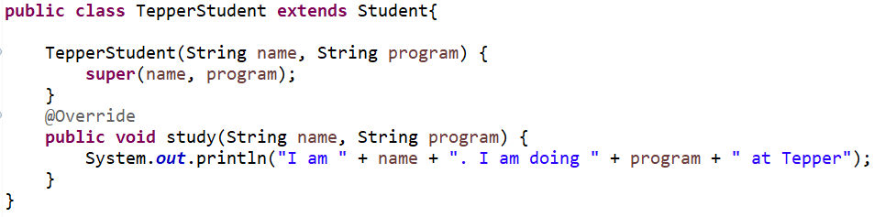
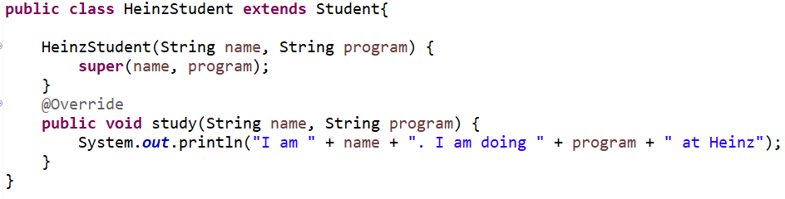

Slide 22
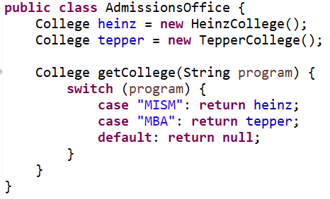
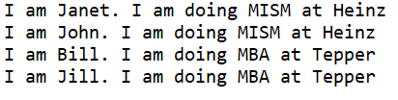
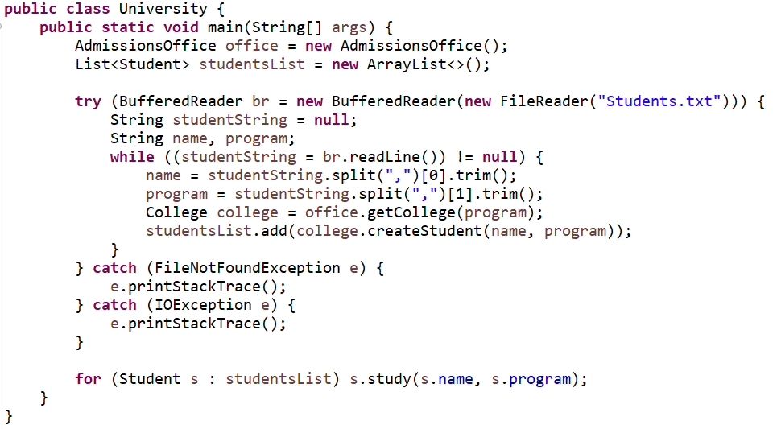
Janet, MISM
John, MISM
Bill, MBA
Jill, MBA
Students.txt
Output

Slide 23
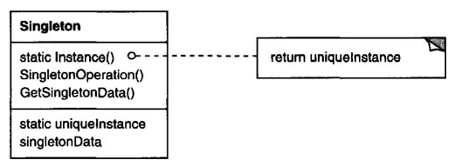
Singleton Pattern
Problem: Restricting the number of instances of a class
Pattern Intent: Ensures a class has only one instance and provides a global access point to it.
Steps:
  Create private constructor of the singleton class
  Make a private static member variable X of the class-type itself
  Create a public static method getInstance() that returns a reference to the instance of singleton class
  getInstance() should instantiate the singleton class only when X is null

Slide 24
Singleton in Python 1
class Singleton:
__instance = None
@staticmethod
def getInstance():
""" Static access method. """
if Singleton.__instance == None:
Singleton()
return Singleton.__instance
def __init__(self):
""" Virtually private constructor. """
if Singleton.__instance != None:
raise Exception("This class is a singleton!")
else:
Singleton.__instance = self
s = Singleton()
print (s)
s = Singleton.getInstance()
print (s)
s = Singleton()
print (s)
<__main__.Singleton object at 0x03E11958>
<__main__.Singleton object at 0x03E11958>
Traceback (most recent call last):
File "C:/…/Singleton.py", line 19, in <module>
s = Singleton()
File "C:/…/Singleton.py", line 12, in __init__
raise Exception("This class is a singleton!")
Exception: This class is a singleton!
Ref: https://www.tutorialspoint.com/python_design_patterns/python_design_patterns_singleton.htm

Slide 25
Singleton in Python 2
class SingletonClass(object):
def __new__(cls):
if not hasattr(cls, 'instance'):
cls.instance = super(SingletonClass, cls).__new__(cls)
return cls.instance
singleton = SingletonClass()
new_singleton = SingletonClass()
print(singleton is new_singleton)
singleton.singl_variable = "Singleton Variable"
print(new_singleton.singl_variable)
True
Singleton Variable
Ref: https://www.geeksforgeeks.org/singleton-pattern-in-python-a-complete-guide/

Slide 26
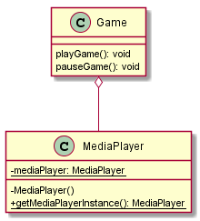
Singleton Pattern
Example: a Game using a MediaPlayer
public class Game {
  MediaPlayer mp;
  void playGame() {
    mp = MediaPlayer.getMediaPlayerInstance();
    //...
  }
  //…other methods
}
public class MediaPlayer {
  private static MediaPlayer mediaPlayer;
  private MediaPlayer() {}
  public static MediaPlayer getMediaPlayerInstance() {
    if (mediaPlayer == null) {
      mediaPlayer = new MediaPlayer();
    }
    return mediaPlayer;
  }
  //...
}

Slide 27
Singleton Pattern
public class MediaPlayer {
  private static MediaPlayer mediaPlayer;
  private MediaPlayer() {}
  public static synchronized MediaPlayer getMediaPlayerInstance() {
    if (mediaPlayer == null) {
      mediaPlayer = new MediaPlayer();
    }
    return mediaPlayer;
  }
  //...
}
Eager instantiation
public class MediaPlayer {
  private static MediaPlayer mediaPlayer = new MediaPlayer();;
  private MediaPlayer() {}
  public static MediaPlayer getMediaPlayerInstance() {
    return mediaPlayer;
  }
  //...
}

Slide 28
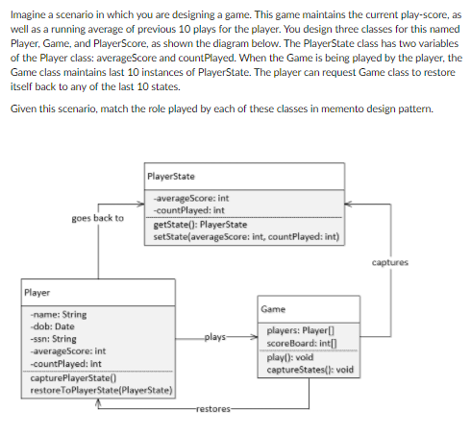
Memento Pattern

Slide 29
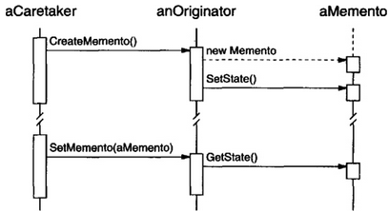
Memento
Intent: Without violating encapsulation, capture and externalize an object’s internal state so that the object can be restored to this state later.
Also known as Token
Participants
  Memento
    Stores internal state of the Originator object (state may be partial)
  Originator
    Creates a memento containing a snapshot of its current internal state
    Uses the memento to restore its internal state
  Caretaker
    Responsible for memento’s safekeeping
    Never operates or examines the memento contents
Memento
Originator
Caretaker

Slide 30
Memento Example
public class PlayerState {
  double score;
  double averageScore;
  int countPlayed;
  PlayerState getState() {
    return this;
  }
  void setState(double score, double averageScore, int countPlayed) {
    this.score = score;
    this.averageScore = averageScore;
    this.countPlayed = countPlayed;
  }
}
These should ideally be private
public class Player {
  //data not stored in history
  private String name;
  private Date dob;
  private String ssn;
  //data to be stored in history
  private double score;
  private static double averageScore;
  private static int countPlayed;
  void play() {
    score = (new Random()).nextInt(10); //some score
    averageScore = (averageScore*countPlayed + score)/ ++countPlayed;
    capturePlayerState();
  }
  void capturePlayerState() {
    PlayerState ps = new PlayerState();
    ps.setState(score, averageScore, countPlayed);
    Game.playerStates.add(ps);
  }
  void restoreToPlayerState(int state) {
    for (int i = Game.playerStates.size()-1; i > state-1; i--)
    Game.playerStates.remove(i);
  }
}

Slide 31
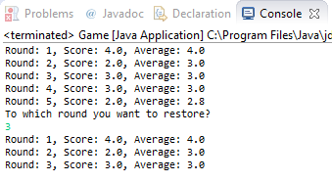
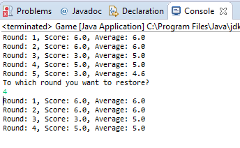
Memento Example
public class Game {
  static final int MAX_STATES = 5;
  static List<PlayerState> playerStates = new ArrayList<>(MAX_STATES);
  static Player player = new Player();
  public static void main(String[] args) {
    Game game = new Game();
    game.play();
    game.prinHistory();
    System.out.println("To which round you want to restore? ");
    int state = (new Scanner(System.in)).nextInt();
    game.restore(state);
    game.prinHistory();
  }
  void play() {
    for (int count = 0; count < MAX_STATES; count++) {
      player.play();
  }
  }
  void restore(int state) {
    player.restoreToPlayerState(state);
  }
  void prinHistory() {
    for (PlayerState ps : playerStates) {
    System.out.printf("Round: %d, Score: %.1f, Average: %.1f%n", ps.countPlayed, ps.score, ps.averageScore);
  }
  }
}

Slide 32
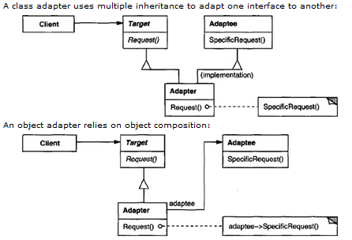
Adapter Pattern
Intent: Convert the interface of a class into another interface client expects.
AKA wrapper
Participant
  Target – defines the domain-specific interface which Client uses
  Adaptee – defines an existing interface that needs adapting
  Adapter – adapts the interface of Adaptee to the Target interface
Adaptee
Targets
Adapters
Notes:
Consider a scenario where you want to work with a stack that gives only push and pop methods. This stack can be implemented by using, say an array of Objects. However, as a client, your program doesn’t need to know anything about array of Objects. The ArrayDeque takes the array of Object elements and implements the push and pop methods on that array. Therefore, the array has been ‘adapted’ or ‘wrapped’ by ArrayDeque class to behave like a stack.

Slide 33
Iterator Pattern
Intent: Provide a way to access the elements of an aggregate object sequentially without exposing its underlying representation
Also known as cursor
Participants
  Iterator – defines an interface for accessing and traversing elements
  ConcreteIterator
    Implements the iterator interface
    Keeps track of the current position in the traversal of the aggregate
  Aggregate – defines an interface for creating an Iterator object
  ConcreteAggregate – implements the Iterator creation interface to return an instance of the proper ConcreteIterator
Iterator pattern in Java

Slide 34
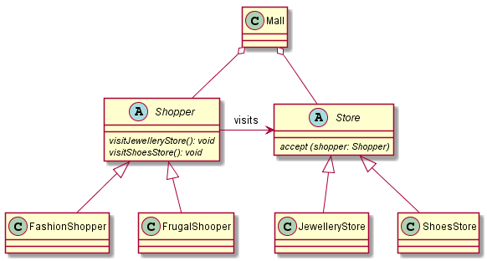
Visitor Pattern

Slide 35
Visitor Pattern
public abstract class Shopper {
  abstract void visitJewelleryStore() ;
  abstract void visitShoeStore();
}
public class FashionShopper extends Shopper{
  @Override
  void visitJewelleryStore() {
    System.out.println("What's the latest in Jewelry?");
  }
  @Override
  void visitShoeStore() {
    System.out.println("What's the latest in Shoes?");
  }
}
public class FrugalShopper extends Shopper{
  @Override
  void visitJewelleryStore() {
    System.out.println("Show me some cheap jewelry");
  }
  @Override
  void visitShoeStore() {
    System.out.println("Show me some cheap shoes");
  }
}

Slide 36
Visitor Pattern
public abstract class Store {
  abstract void accept (Shopper shopper);
}
public class JewelleryStore extends Store{
  @Override
  void accept(Shopper shopper) {
    shopper.visitJewelleryStore();
  }
}
public class Mall {
  public static void main(String[] args) {
    //create stores
    List<Store> stores = new ArrayList<>();
    stores.add(new JewelleryStore());
    stores.add(new ShoeStore());
    //create shoppers
    List<Shopper> shoppers = new ArrayList<>();
    shoppers.add(new FashionShopper());
    shoppers.add(new FrugalShopper());
    for (Shopper shopper : shoppers) {
      for (Store store: stores)
        store.accept(shopper);
    }
  }
}
public class ShoesStore extends Store {
  @Override
  void accept(Shopper shopper) {
    shopper.visitShoeStore();
  }
}

Slide 37
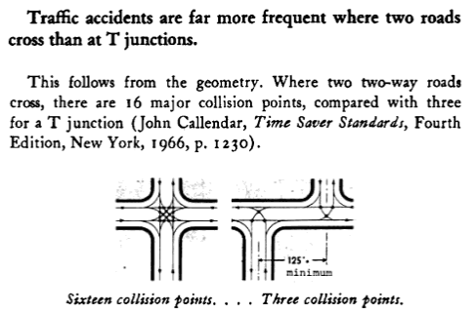
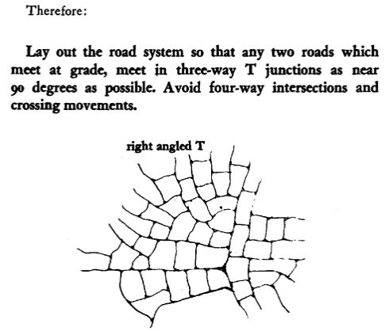
A Pattern Language: Towns, Buildings, Construction
Pattern name: T-Junction
Principles and Patterns

